Slide 1

APEX INSTITUTE OF TECHNOLOGY
DEPARTMENT OF COMPUTER SCIENCE & ENGINEERING
Agile Practices (22CSH-292)
Faculty: Mamta Sharma(E15565)
Lecture1.3.3: scenio
DISCOVER . LEARN . EMPOWER

Slide 2
Learning Outcome of this lecture
CO1 | Understand the Agile Methodology and comparing various other software development models with agile.
CO2 | Examine Scrum and test driven development
CO3 | Apply the various tools available to agile teams to facilitate the project
CO4 | Analyze the method to improve results for a specific circumstance
CO5 | Evaluate likely successes and formulate plans to manage likely risks or problems

Slide 3
Learning Outcome of this lecture
Unit | Name | Outcome
I | Understanding common Agile Practices in DevOps | Introduction to Product Management, Product Design and Requirement gathering, Product Design Challenges, UX Design, Product Development Methodologies, Product Marketing and Presentation, Traditional Software Development Methodologies, Problem/issues with traditional approach, Agile Development, Agile Manifesto, Scrum Model, Agile Estimations and Planning, Soft skills in agile
CO 1 Apply the Agile Methodology and comparing various other software development models with agile
T

Slide 4
Outline
Playbacks
To be Scenario Map
Sponsor Users

Slide 5
Playback
Playbacks are regular check-ins that bring users, stakeholders and teams together to tell stories and exchange feedback. They allow us to measure progress on a regular basis while uncovering and addressing any misalignment that may exist.
The value of playbacks
Playbacks help ensure that the team is aligned on the personas that will use the service and the scenarios that will be included to satisfy the MVP.
Playbacks in practice
Effective playbacks incorporate these practices:
• Being concise
• Scheduling enough time to listen to stakeholder feedback
• Focusing on the value of the scenario rather than the technical implementation details

Slide 6
Playback
Client playbacks
Internal playbacks are valuable, but it is also important to get direct client feedback.
Throughout the project, the product manager and design lead might want to hold playback meetings with clients who represent the personas that will use the service or product.
Through these playbacks, the team obtains feedback that it can use to improve the product and focus on what the customer really wants.

Slide 7
To be scenario
To-be Scenario Maps can help you envision a better future for your users.
Use them as you’re coming up with potential solutions to see how your ideas would fit within your user’s world, and how they might address their needs. A To-be Scenario Map is a great artifact to put in front of stakeholders and users to align on your team’s intent.

Slide 8
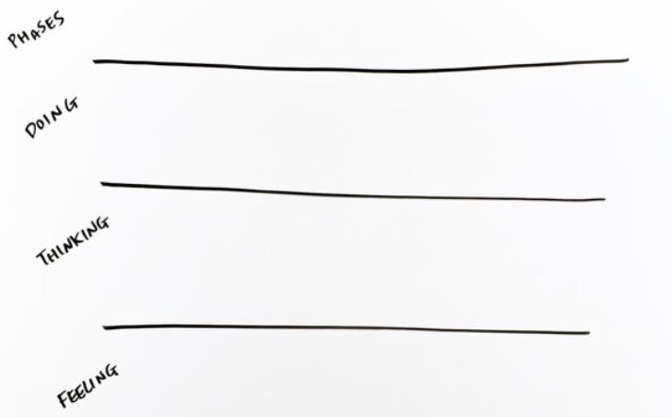
To be scenario
Set up the activity
Draw four rows and label them: Phases, Doing, Thinking, and Feeling.

Slide 9
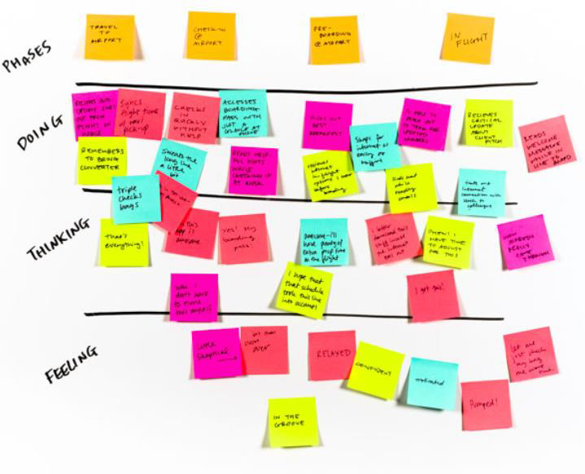
To be scenario
Brainstorm individually
Imagine your ideas exist in reality. Fill in the corresponding rows, using one sticky note per answer.

Slide 10
To be scenario
Review and identify phases
Cluster similar stickies and refine the order, draw rough columns that represent the unique phases of your user’s future experience.

Slide 11
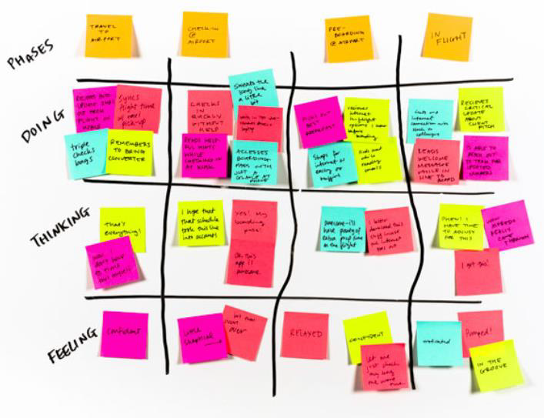
To be scenario
Review and identify phases
Cluster similar stickies and refine the order, draw rough columns that represent the unique phases of your user’s future experience.

Slide 12
Text Books and Reference Books
T1 Agile Project Management with Kanban - Book by Eric Brechner
T2 Agile Foundations: Principles, Practices and Frameworks – Peter Measey
Reference Books:
1 Agile Project Management with Kanban Eric Brechner 2nd Microsoft Press 2021
2 Agile Foundations Peter Measey(4th BCS,) The Chartered Institute for IT 2015

Slide 13
References
https://www.mygreatlearning.com/blog/importance-of-design-thinking/
https://www.interaction-design.org/literature/article/5-stages-in-the-design-thinking-process
https://en.wikipedia.org/wiki/Design_thinking

Slide 14
THANK YOU
For queries
Email:mamta.e15565@cumail.in

